Slide 1
What is SOA?
SOA – Service Oriented Architecture
  S – Service is basically an independent component that has a certain function. (e.g. Viewing online bank statement, filling out an app for an account). Emphasis on modularity and loose coupling (implementation hidden)‏
  A – Architecture basically means this is not a technology but an approach to software design

Slide 2
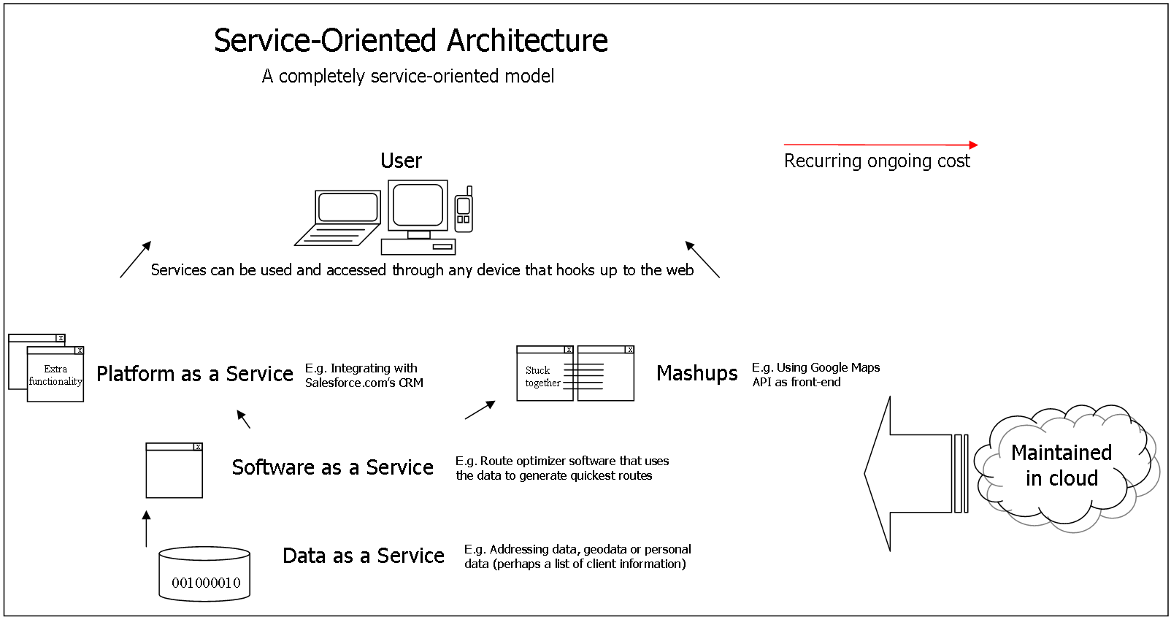

Slide 3
What is SOA?
How do services talk to eachother?
  In the past through COMs or ORBs, but recent SOAs using Web Service (i.e. XML based messaging)‏
  Adhoc philosophy
  Platform, language, OS independent.
  More recently, services are being offered for a price, like in the travel industry, financing, using off the shelf software services

Slide 4
What is Amazon S3?
S3 = Simple Storage Service
A SOA which provides online storage using web services.
Allows read, write, and delete permissions on objects
Uses REST and SOAP protocols for messaging, so you can use various development toolkits with S3.

Slide 5
How it Works
Store data on Amazon’s distributed system containing multiple servers within Amazon’s data center locations
Data takes time to propagate
Can store it in North America or Europe
Amazon doesn’t offer you a GUI based tool to access your data. You can use one of the several tools online or build one through APIs

Slide 6
Amazon S3 - Components
Objects
  The information you're storing.
  Consist of
    metadata
      System Metadata – Request ID Headers, useful for Amazon staff
      User Metadata - 2kb Max. Date last modified, file size, or anything else you would like.
    Data (5GB Max)‏

Slide 7
Amazon S3 - Components
Buckets
  Container.
  Each object is inside of a container.
  Buckets are owned by an AWS account
  http://mybucket.s3.amazonaws.com
  If you have a file called hi.txt in the above bucket, it would be stored in http://mybucket.s3.amazonaws.com/hi.txt

Slide 8
Amazon S3 - Components
Keys
  Files are represented as unique keys within a bucket.
  In reality the key is basically your file name
    Example: http://bucket.s3.amazonaws.com/file.txt
    file.txt is the unique key

Slide 9
Amazon S3 - Operations
Use either the REST or SOAP API to do the following and more
  Create a bucket
  Write an object
  Read an object
  Delete an object (Be careful not to rapidly create and delete an object)‏
  List the keys (files)‏

Slide 10
Amazon S3 – Build your own APP
Java Example Operations
// Access Key – Identified you as the requester. Associated with your // account, this is sent in plaintext in the message
//Secret Access Key – Used to generate a signature, not sent as //plaintext
AWSAuthConnection conn =
new AWSAuthConnection("[aws-access-key-id]", "[aws-secret-access-key-id]");
Response response = conn.createBucket("[bucket-name]", null);
if (response.connection.getResponseCode() == 200)
{
// bucket was created
}
else
{
// something bad happened
}

Slide 11
Amazon S3 – Java Example Operations
// simple list
ListBucketResponse response =
conn.listBucket("[bucket-name]", null, null, null, null);
List objects = response.entries;
for (Iterator it = objects.iterator(); it.hasNext(); ) {
ListEntry entry = (ListEntry)it.next();
System.out.println("key = " + entry.key + " size = " + entry.size);
}
// list only things starting with "foo"
response = conn.listBucket("[bucket-name]", "foo", null, null, null);
// list only things that come after "bar" alphabetically
response = conn.listBucket("[bucket-name]", null, "bar", null, null);
// only list 3 things
response = conn.listBucket("[bucket-name]", null, null, new Integer(3), null);

Slide 12
Amazon S3 – Your Data
Put a new object
  Direct Internet Message Encapsulation (DIME) is a specification for sending and receiving SOAP messages along with additional attachments
//HEADER
00001 1 0 0 0010 000000000000000000000000000000000000 000000000010100000000000000000000000000110110101
http://schemas.xmlsoap.org/soap/envelope
<soap-env:Envelope
xmlns:soap-env=http://schemas.xmlsoap.org/soap/envelope/
xmlns:msg=http://example.com/DimeExample/Messages/
xmlns:ref= http://schemas.xmlsoap.org/ws/2002/04/reference/
<soap-env:Body>
<msg:GetMediaFile>
<msg:fileName>myMediaFile.mpg
</msg:fileName>
<msg:file ref:location=
"uuid:F2DA3C9C-74D3-4A46-B925-B150D62D9483" />
</msg:GetMediaFile>
</soap-env:Body>
</soap-env:Envelope>
-------------------------------------------------------------------------
00001 0 0 1 0001 000000000000000000000000000000101001 000000000000101000000000000101011010101011100000 uuid:F2DA3C9C-74D3-4A46-B925-B150D62D9483
video/mpeg
<<First 1.42 MB of binary data for myMediaFile.mpg>>
-------------------------------------------------------------------------
00001 0 1 0 0000 000000000000000000000000000000000000 000000000000000000000000000010000110110001000000
<<Remaining 552 KB of binary data for myMediaFile.mpg>>

Slide 13
Amazon S3 – Other Supported Languages
C#, Perl, PHP, Ruby, Python

Slide 14
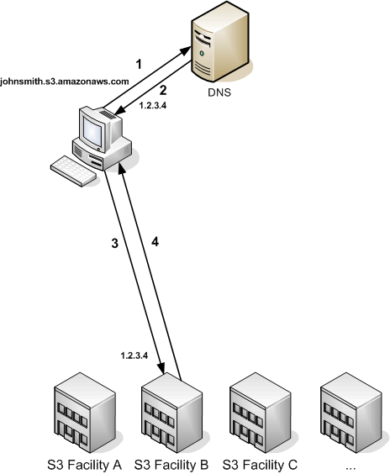
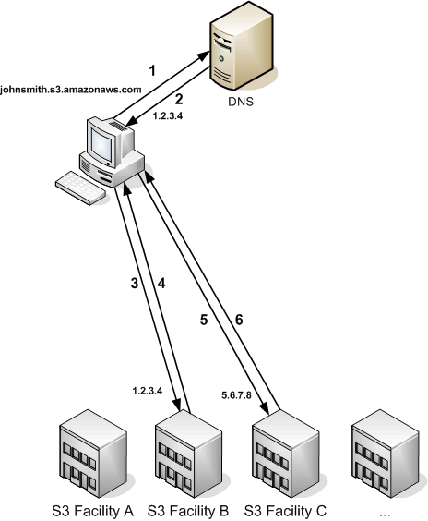
Amazon S3 – Other Options
Redirect Routing when route error

Slide 15
Cost
United States
Storage
  $0.150 per GB – first 50 TB / month of storage used
  $0.140 per GB – next 50 TB / month of storage used
  $0.130 per GB – next 400 TB /month of storage used
  $0.120 per GB – storage used / month over 500 TB
Data Transfer
  $0.100 per GB – all data transfer in
  $0.170 per GB – first 10 TB / month data transfer out
  $0.130 per GB – next 40 TB / month data transfer out
  $0.110 per GB – next 100 TB / month data transfer out
  $0.100 per GB – data transfer out / month over 150 TB
Requests
  $0.01 per 1,000 PUT, COPY, POST, or LIST requests
  $0.01 per 10,000 GET and all other requests*
* No charge for delete requests

Slide 16
Summary
SOA allows us to access services we want without having to worry about language, platform, OS diversity
Amazon S3 is an easy to use service that allows us to store data on their facilities for a minimal cost, potentially using it for things like torrenting, web hosting, ftp app, online backups, etc.

